Slide 1
Types of Machine learning

Slide 2
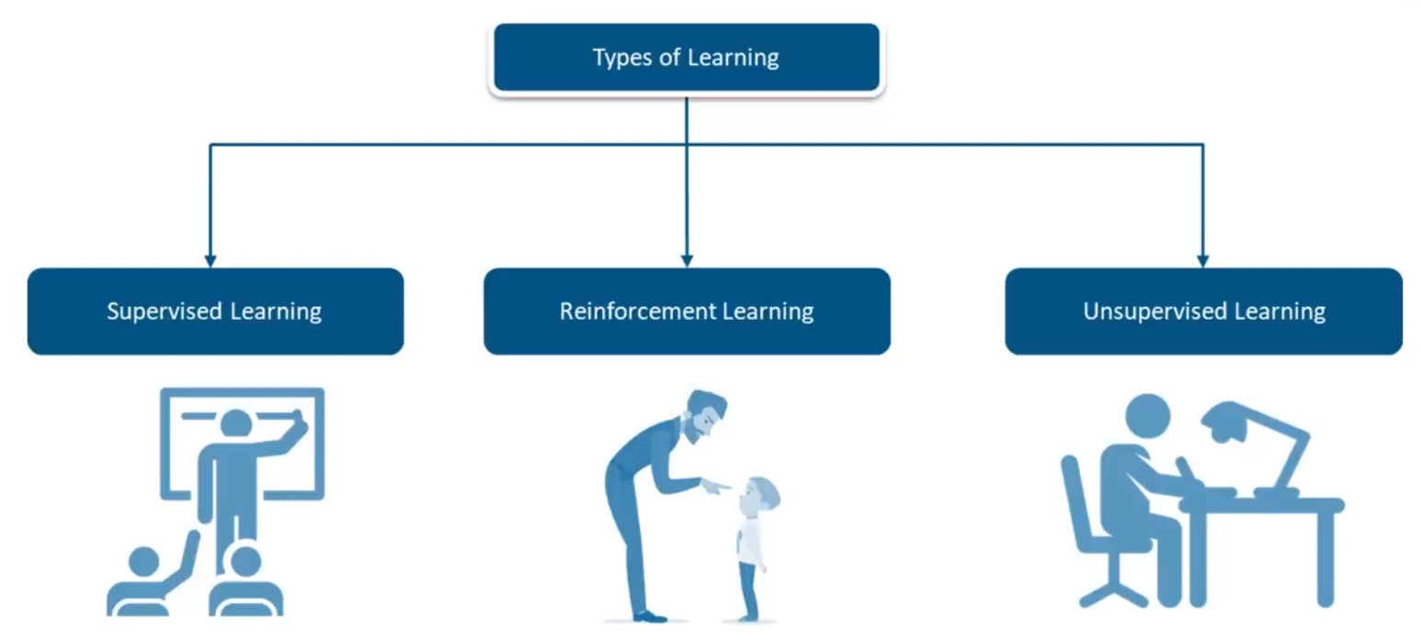
Types of machine leaning algorithms
Supervised machine learning algorithms
Unsupervised machine learning algorithms
Reinforcement machine learning algorithms

Slide 3
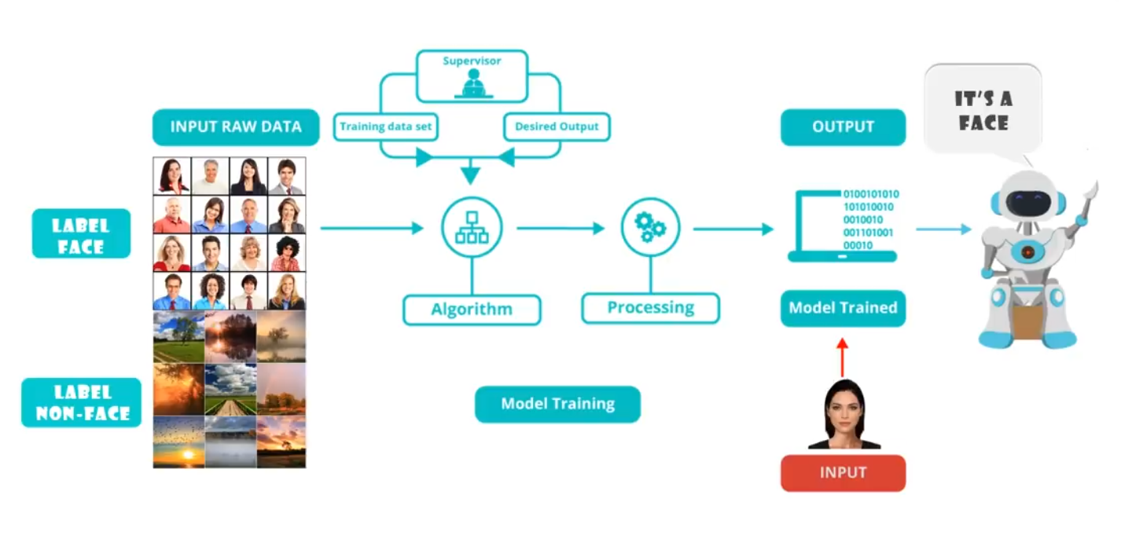
Supervised Learning(1/2)

Slide 4
Supervised Learning(2/2)
With the knowledge of a previous set of labelled input and output data, the machine develops a correlation which can predict the outputs for such input values in the near future
Applications:
face and speech recognition
Products/movie recommendations
sales forecasting
Examples:
Google Assistant/Cortana can identify your voice once you trained its voice model
Facebook gives you friend suggestions based on the pics you were tagged in
DEEPFACE ALGORITHM: Facebooks’ image recognition algorithm for photo tagging

Slide 5
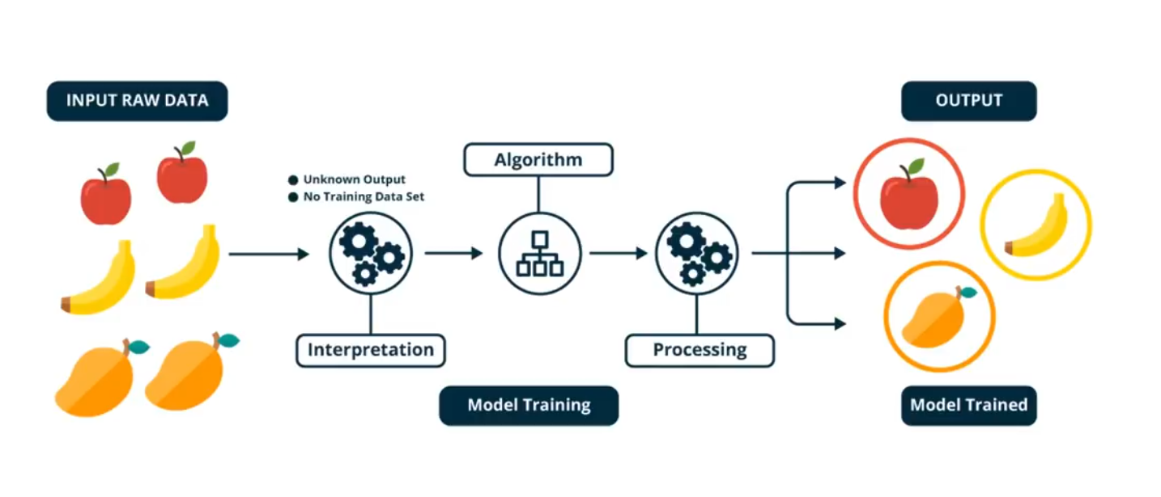
Unsupervised learning(1/2)

Slide 6
Unsupervised learning)2/2)
With the available set of unlabelled and unstructured data, the machine identifies and infers a hidden pattern of the data
Ex:
Detecting fraudulent bank transactions by grouping the transaction sequential data
Amazon’s personal product promotion based on recent purchase history

Slide 7
Reinforced learning
Allows machines and software agents to automatically determine the ideal behavior within a specific context in order to maximize its performance.
Ex:
PC games like Creatures & Halo series increase the difficulty levels for any specific player once it learns the player stats
HALO SERIES also uses the machine learning for prototype testing to increase the user experience

Slide 8
Thank you

